Slide 3
Proteobacteria

Slide 5
Firmicutes

Slide 7
Actinobacteria

Slide 9
Euryarchaeota

Slide 11
Deinococcus-Thermus

Slide 13
Cyanobacteria

Slide 15
Crenarchaeota

Slide 17
Bacteroidetes

Slide 19
Chlamydiae

Slide 21
Spirochaetes

Slide 23
Tenericutes

Slide 25
Thermotogae

Slide 27
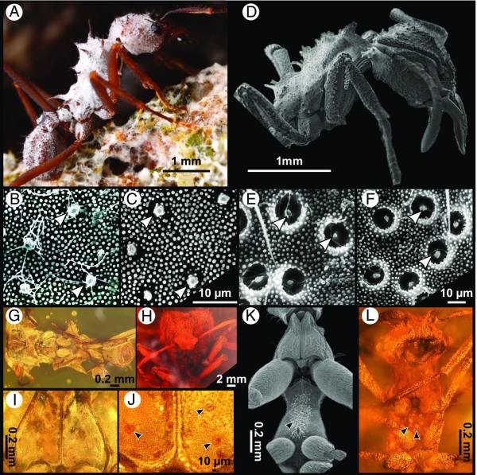
30282739

Slide 28
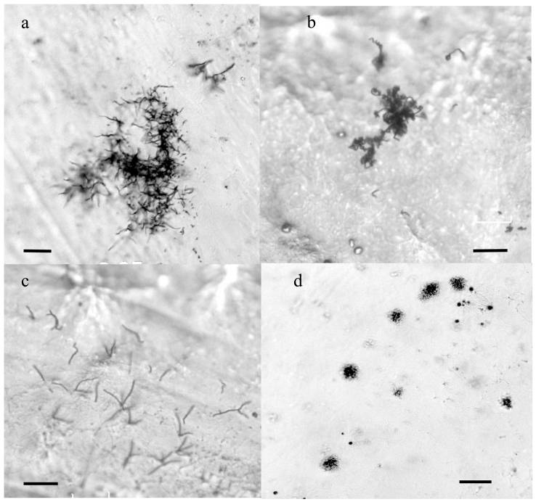
18255181

Slide 29
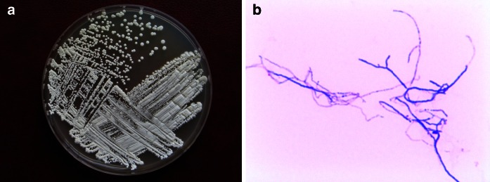
25382928

Slide 30
Residue

Slide 31
PO₃²⁻
O
R

Slide 32
Phyla

